Slide 1


100 BEST MOVIES ON AMAZON PRIME
Group # 10
Ani Thomas
AI Rehnaz
Monse Michael
Jasmeet Kaur Sura

Slide 2
Link for video
Group # 10
Ani Thomas
AI Rehnaz
Monse Michael
Jasmeet Kaur Sura

Slide 3
Contents
Web Scraping
Collect 100 entries
Creating data model
Uploading data to mongo dB
Creating CRUD application

Slide 4
About The Data Source
Rotten Tomatoes is the one of the world’s most trusted recommendation resources for quality entertainment. As the leading online aggregator of movie and TV show reviews from critics, we provide fans with a comprehensive guide to what’s Fresh – and what’s Rotten – in theaters and at home.
Why Rotten tomatoes :
Everyone likes to watch quality entertainment therefore this site is one way to find what is new and entertaining. Link: https://www.rottentomatoes.com/

Slide 5
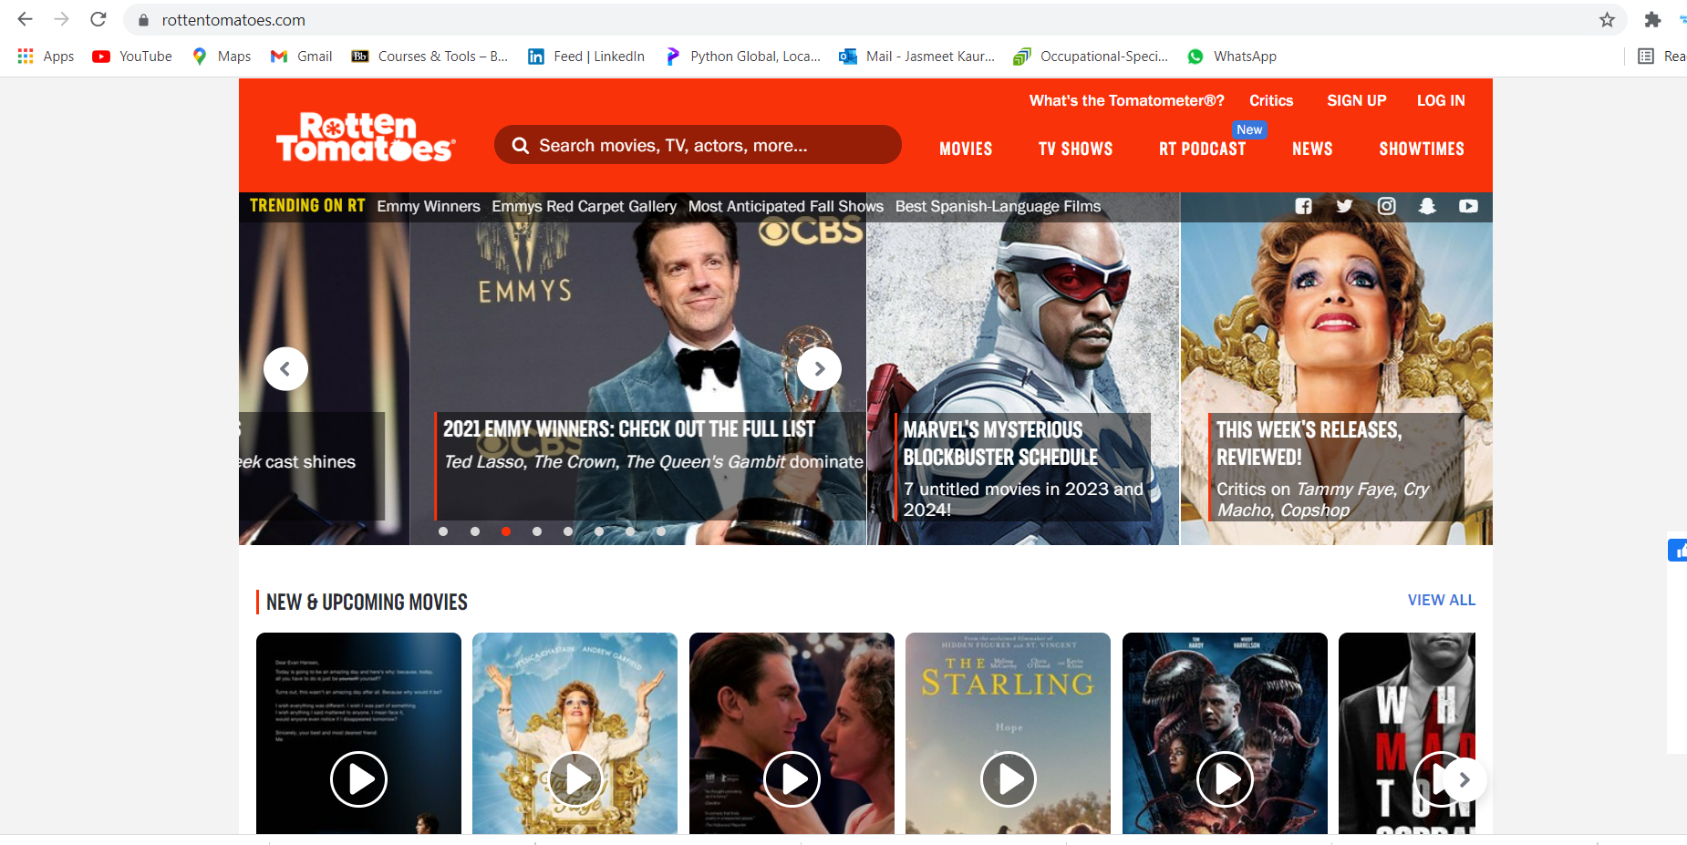

Slide 6



Project Flow chart
Website Scraping using python
Flask is used for web application
Database created in Mongo db

Slide 7
team
Ani Thomas Web Developer
Monse Michael Data analyst
Al Rehnaaz
Data Architect
Jasmeet Kaur Sura Business Analyst

Slide 8
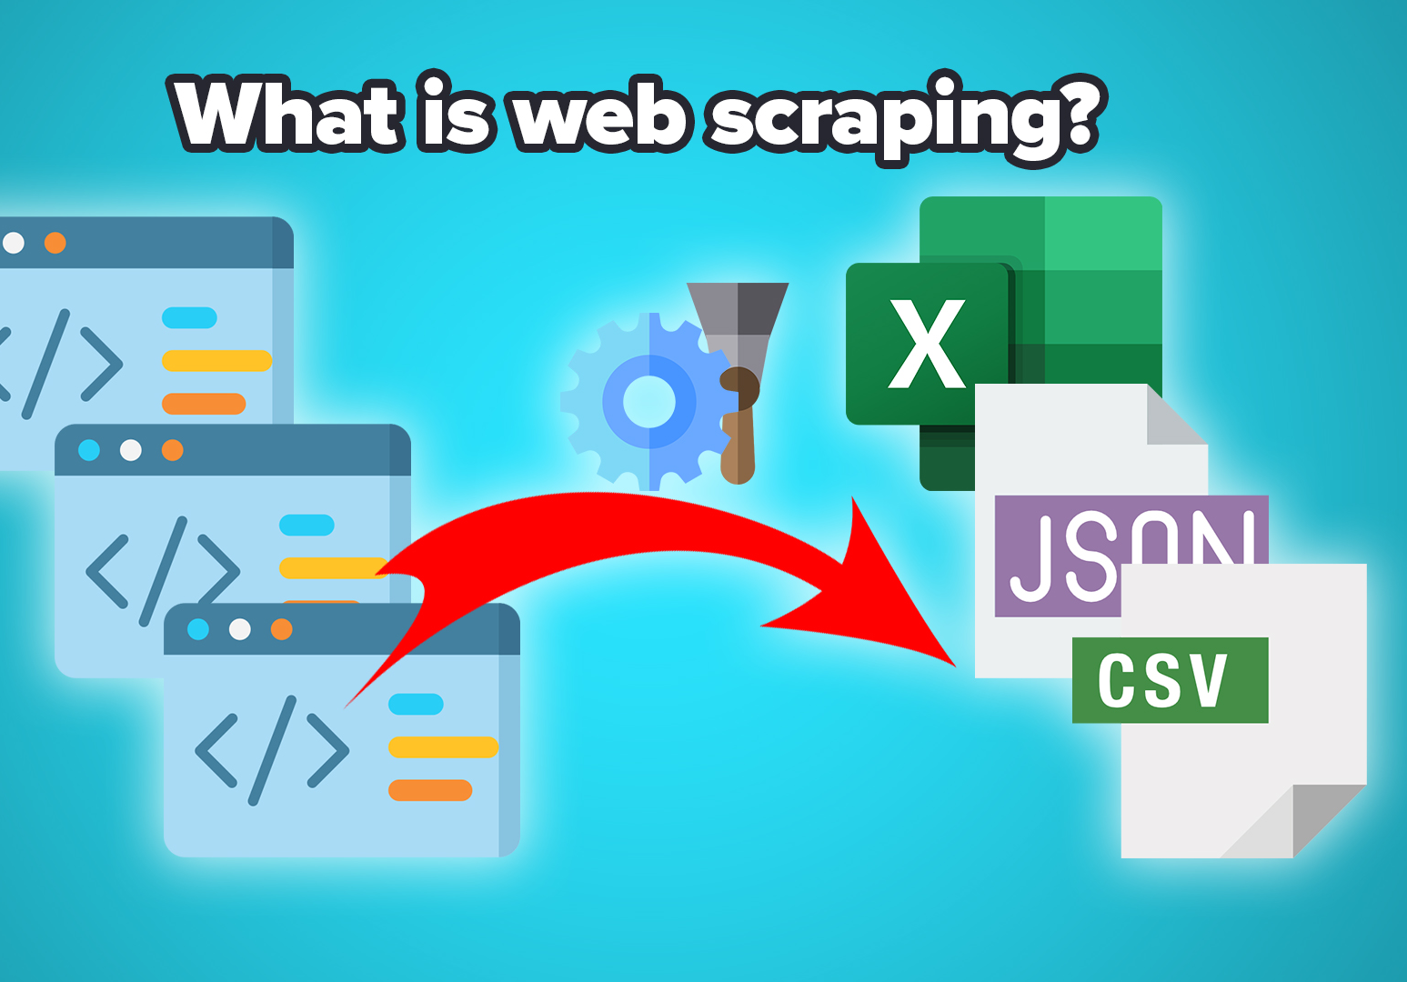
What is Web Scraping?
Web scraping is the process of using coding languages like python to extract content and data from a website.
In this process website is directly accessed by the web site scraping software. Beautiful Soup is a library for pulling data out of HTML and XML files using different html tags and libraries like Pandas is used store it in a csv file.

Slide 9

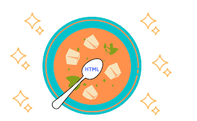
What is ?
Beautiful Soup is a Python library for pulling data out of HTML, XML files other markup languages.
Some webpages that display data but that do not provide any way of downloading the data directly. Beautiful Soup helps to pull particular content from a webpage, remove the HTML markup, and save the information.

Slide 10
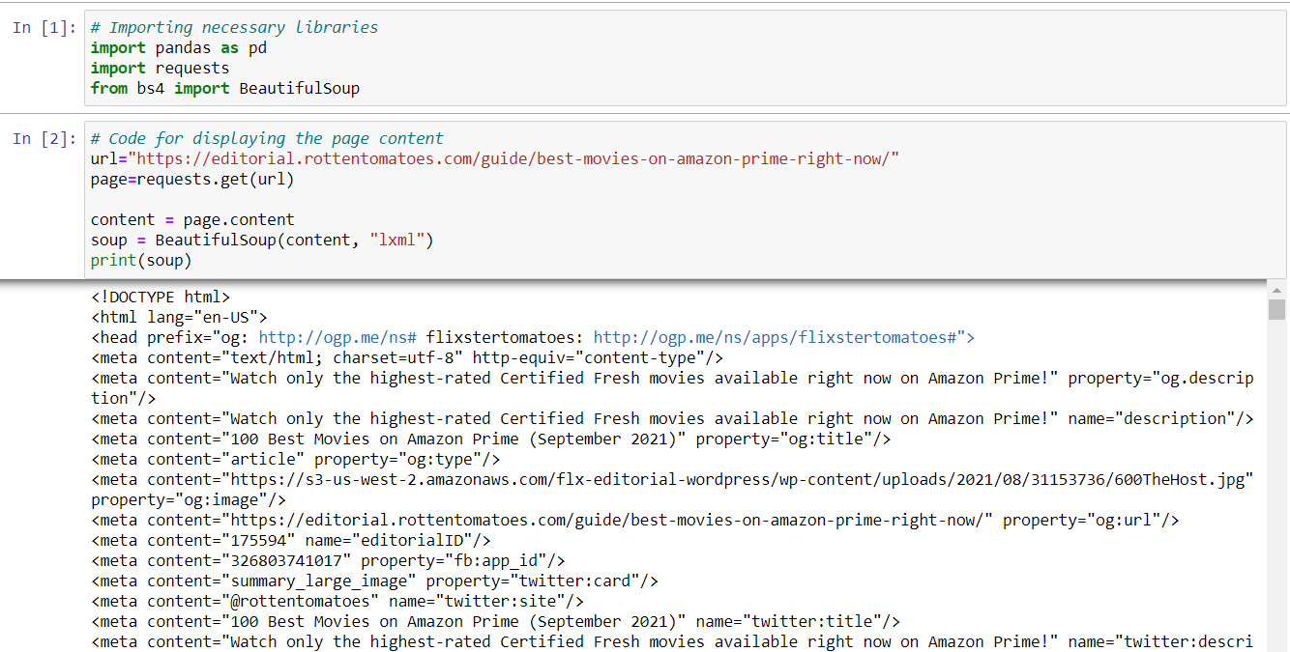
Web Scraping- Data Collection

Slide 11
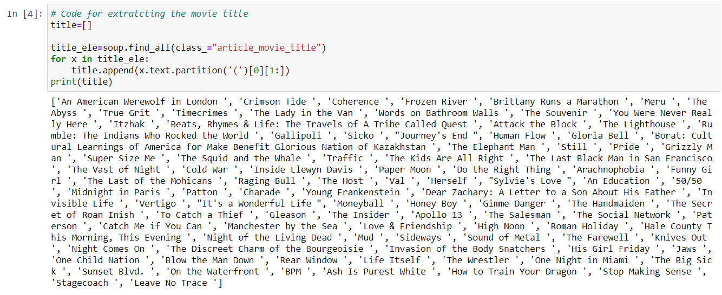
Web Scraping- Data collection

Slide 12
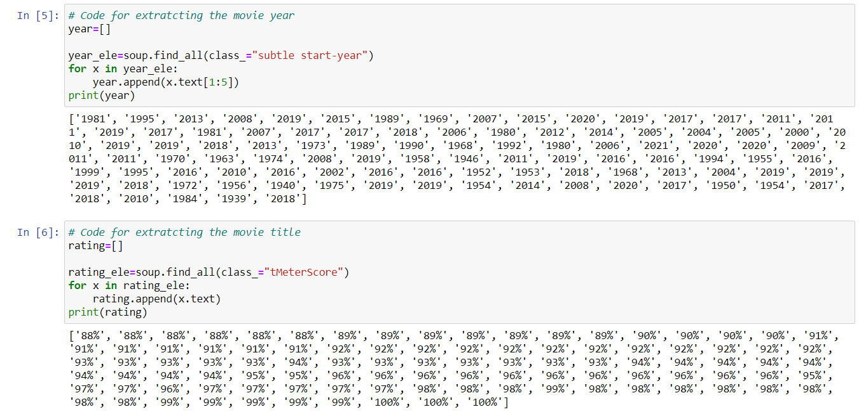
Web Scraping- Data collection

Slide 13
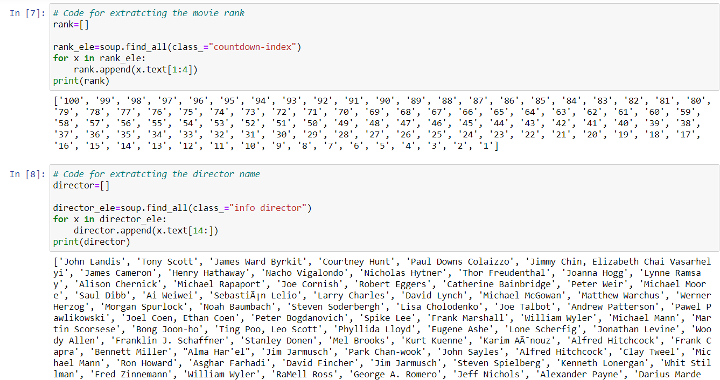
Web Scraping- Data collection

Slide 14
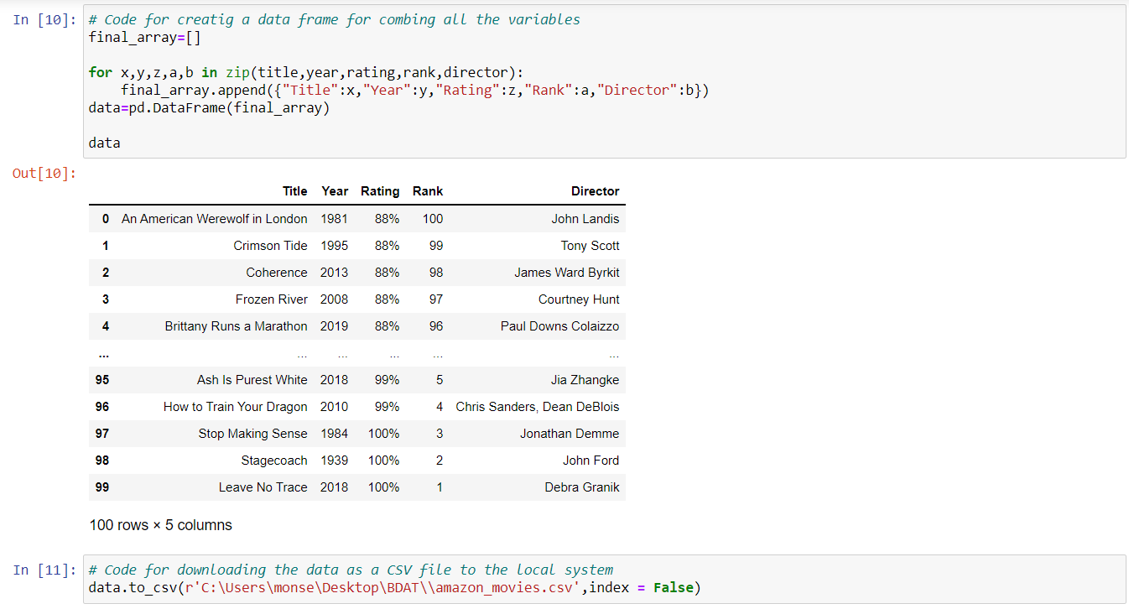
Web Scraping- Data Model

Slide 15
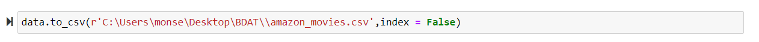
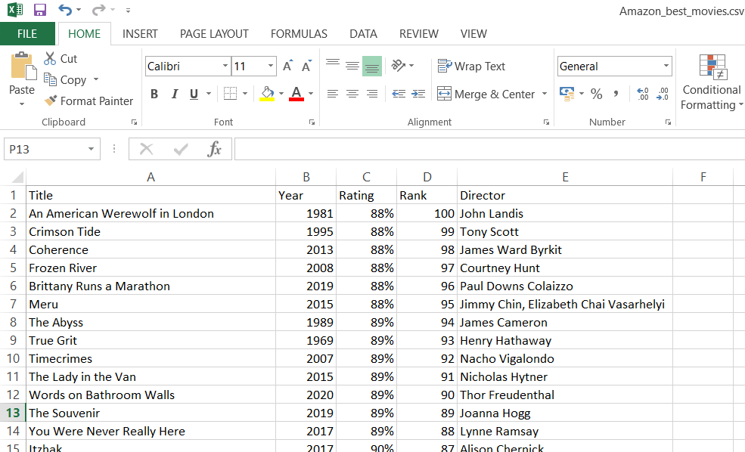
Web Scraping- Data to a CSV File

Slide 16
Data Model
Field | Description
Title | Title of movie
Year | Release year
Rating | Rating given by the site
Rank | Rank (1-100)
Director | Director of the movie

Slide 17
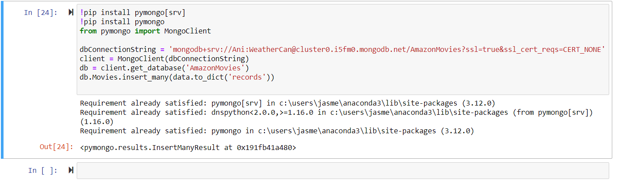
Connection to mongo dB

Slide 18
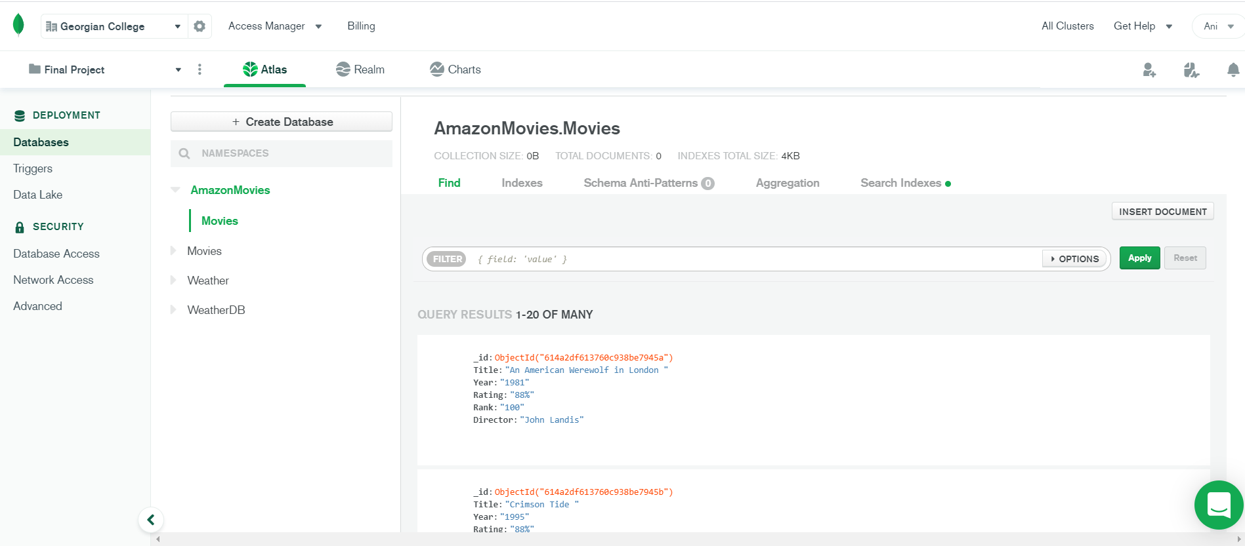
Connection to mongo dB

Slide 19
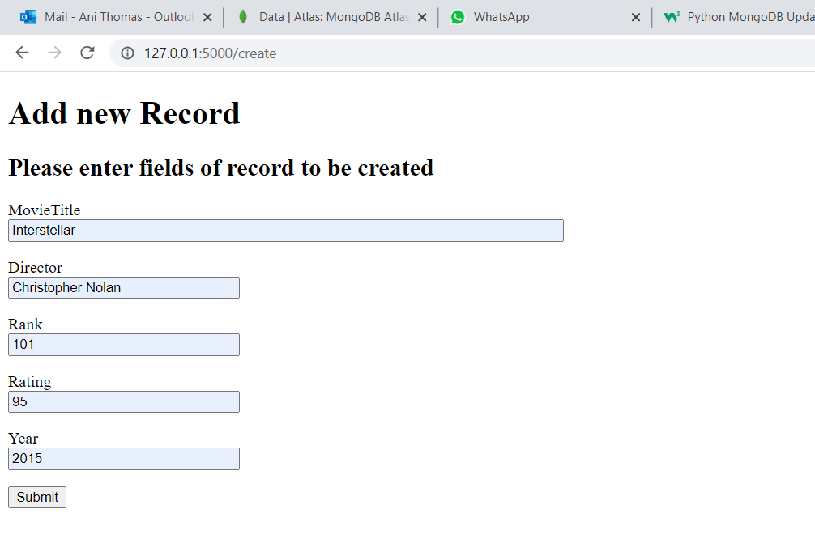
CRUD WEB APPLICATION-(Create)

Slide 20
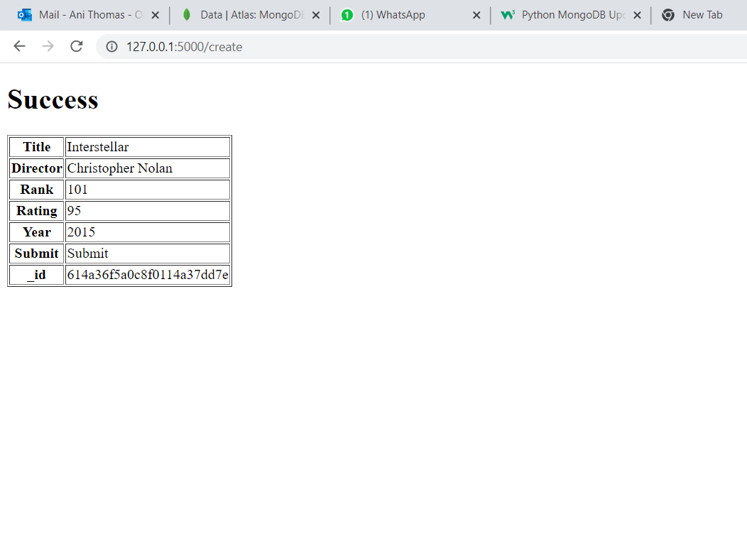
CRUD WEB APPLICATION-Create

Slide 21
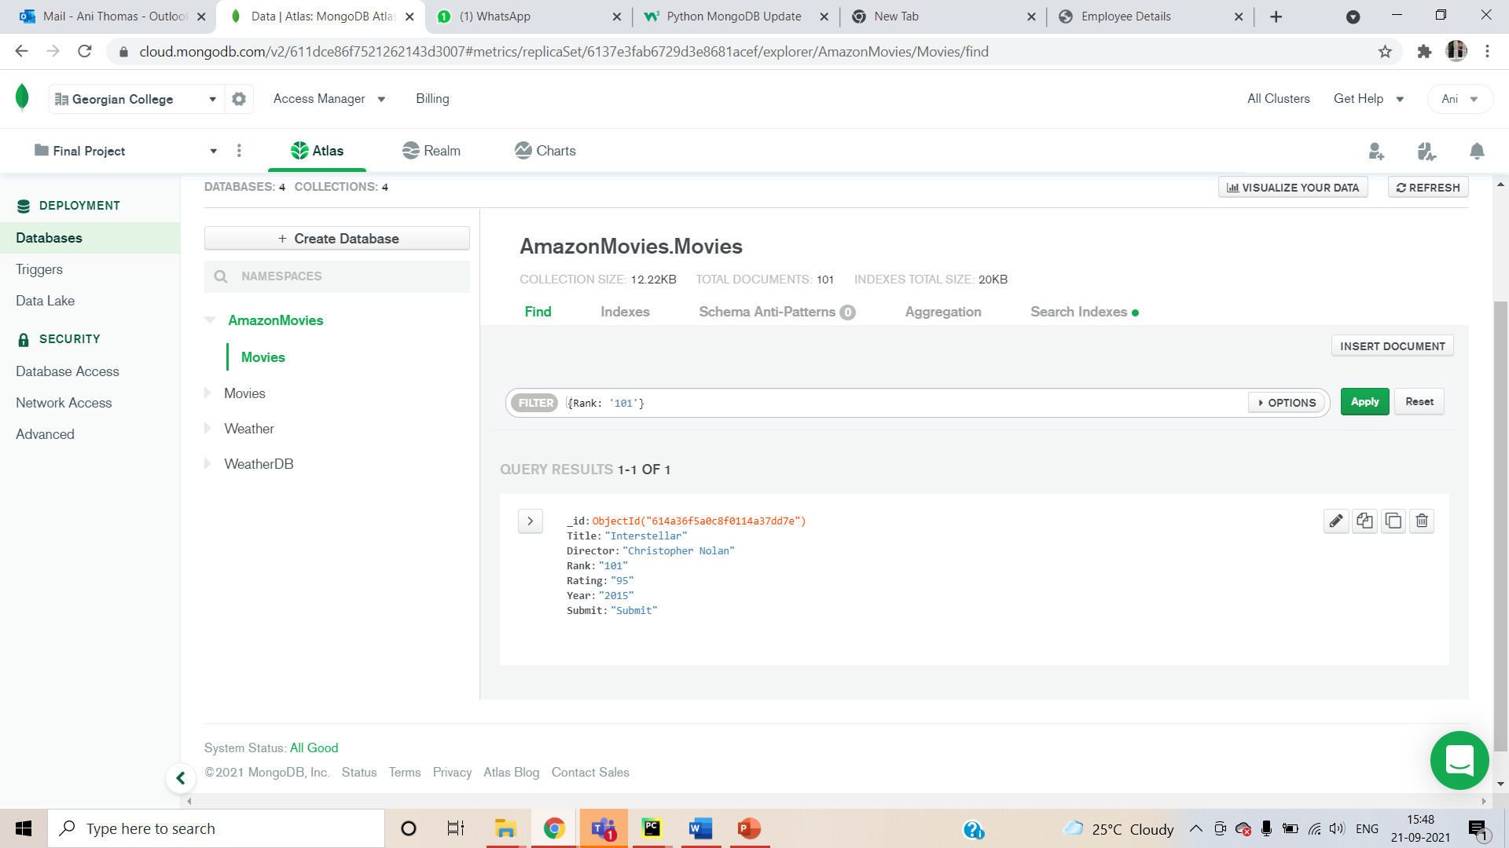
CRUD WEB APPLICATION- insert into db

Slide 22
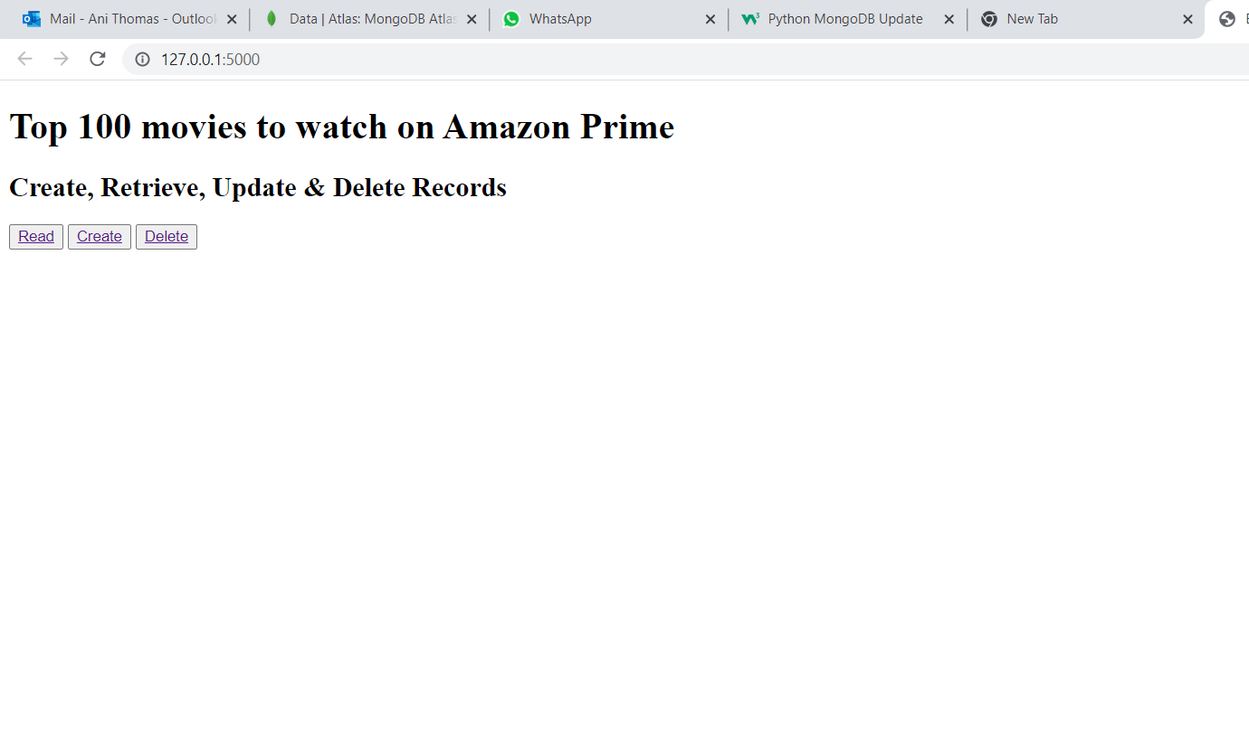
CRUD WEB APPLICATION - Read

Slide 23
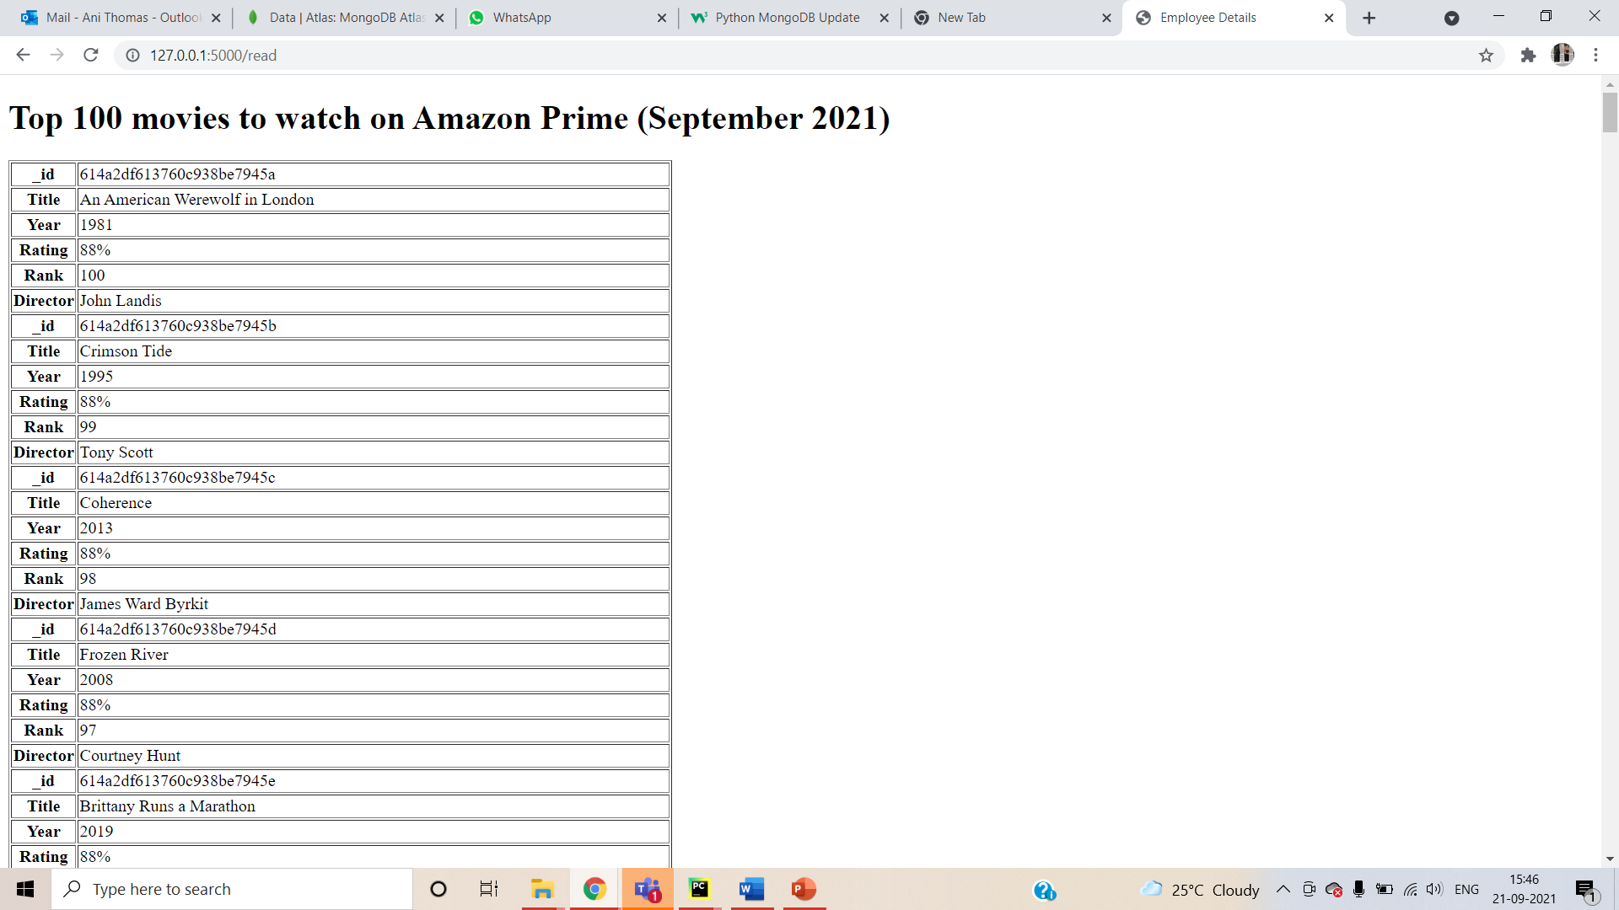
CRUD WEB APPLICATION-(Read)

Slide 24
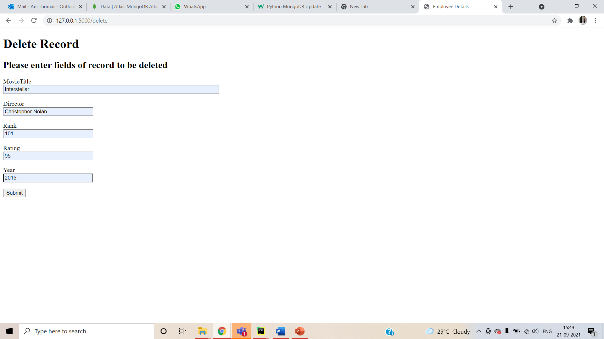
CRUD WEB APPLICATION-(Delete)

Slide 25
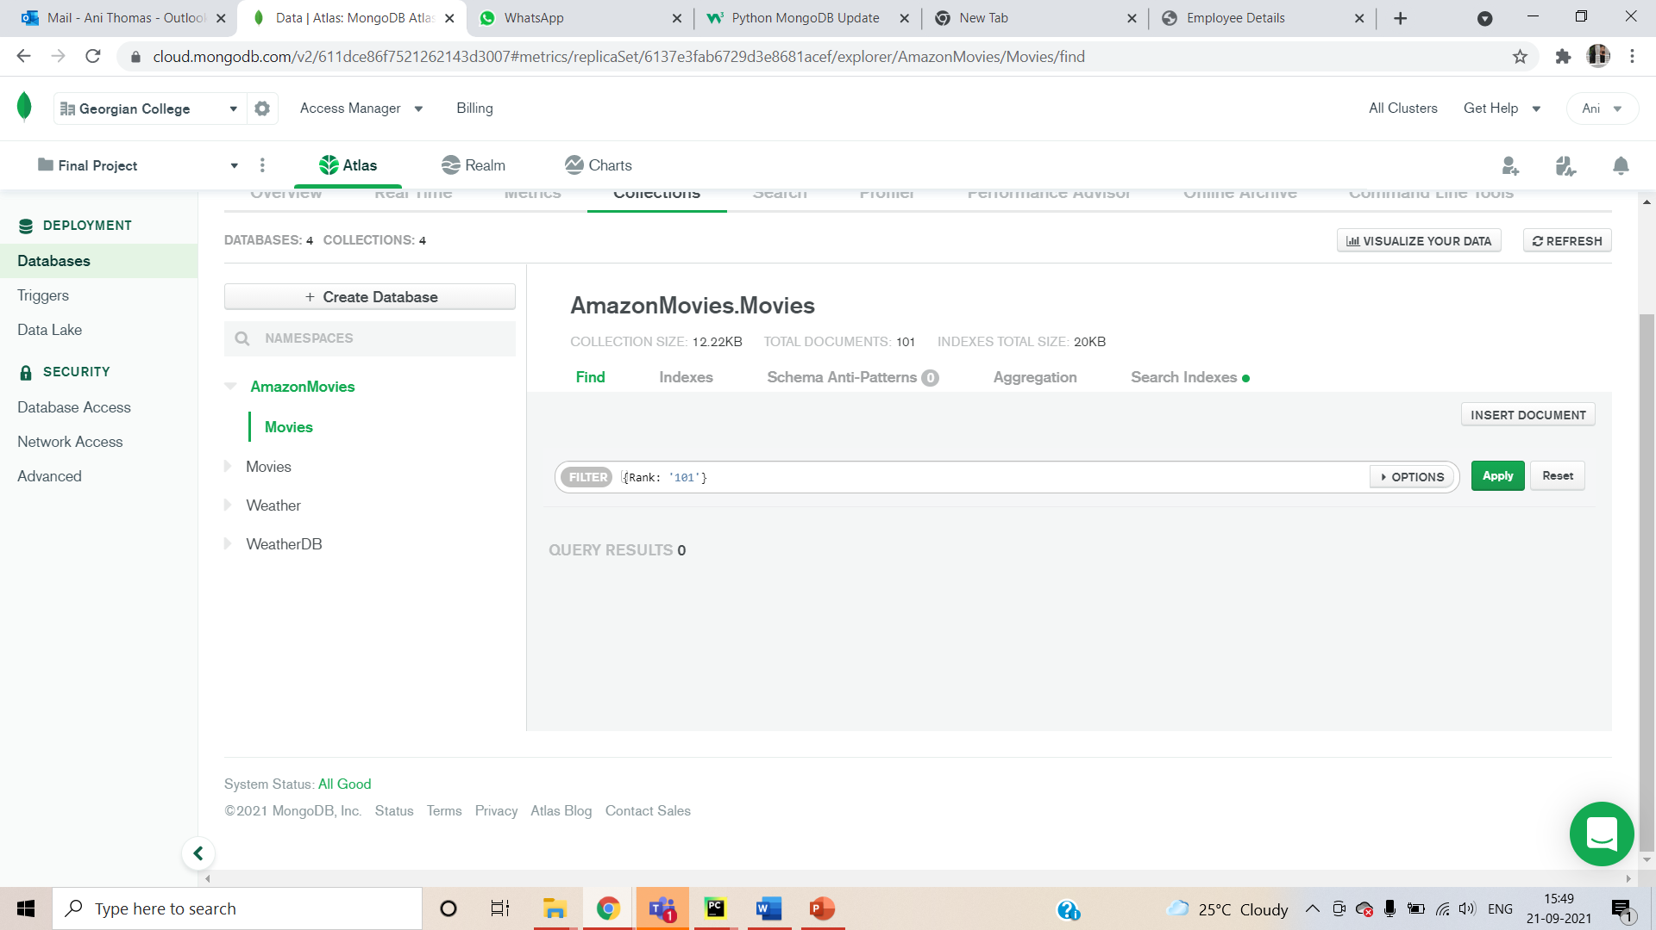
CRUD WEB APPLICATION-(Delete)

Slide 26
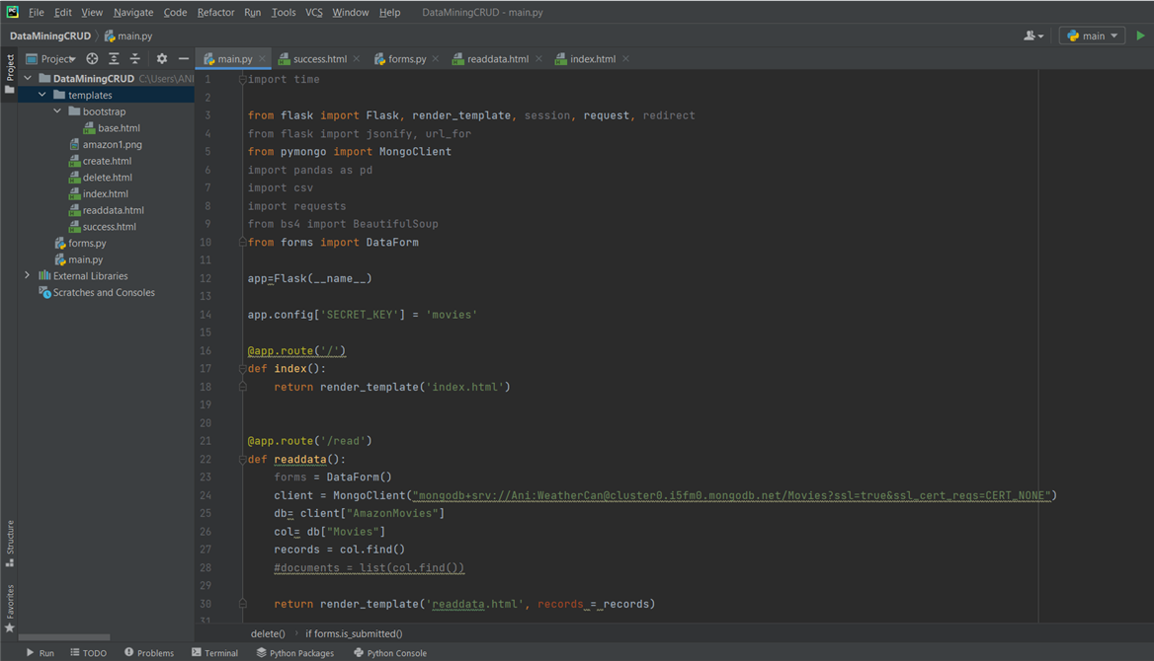
CRUD WEB APPLICATION

Slide 27
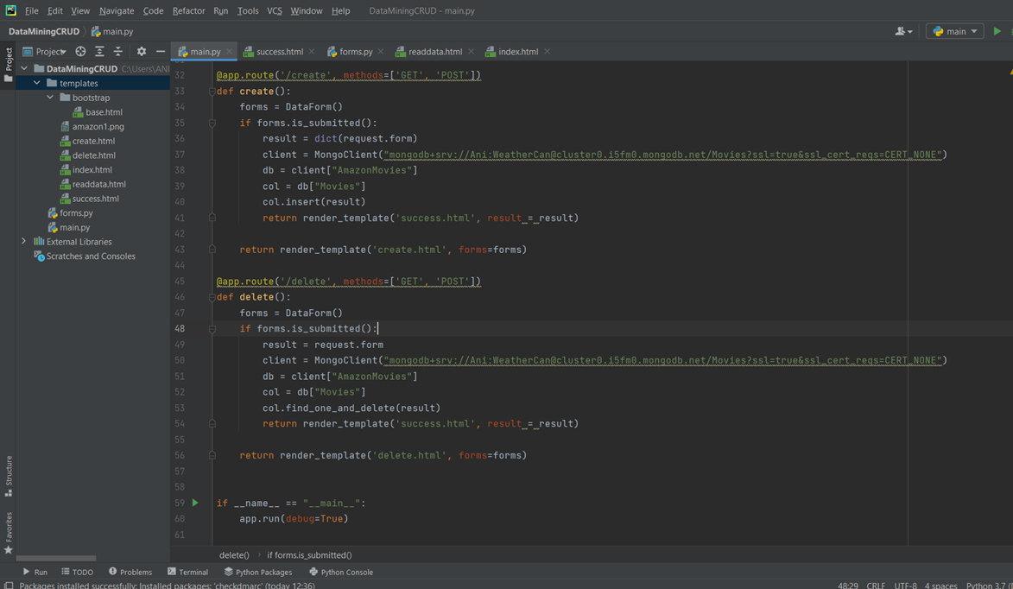
CRUD WEB APPLICATION

Slide 28
Thank You!

